Slide 1

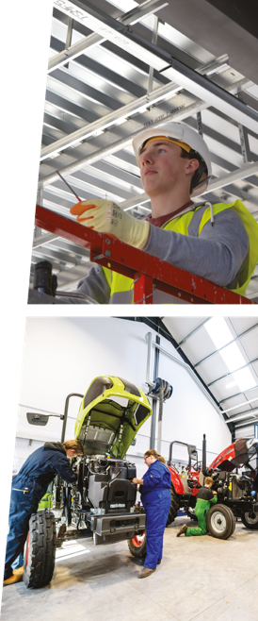

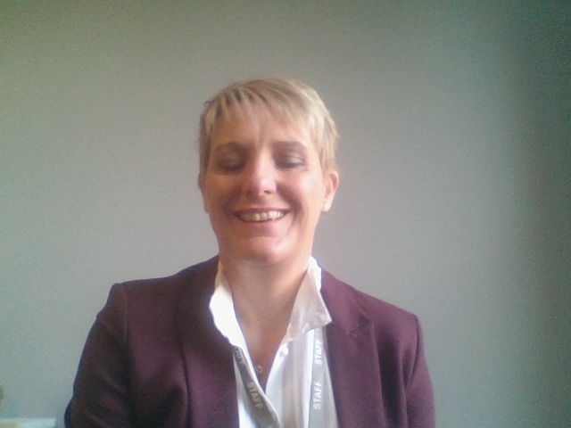
Head of Apprenticeships
Josephine Brammer
Introduction
INDUSTRY FOCUSED, CAREER ​READY​

Slide 2

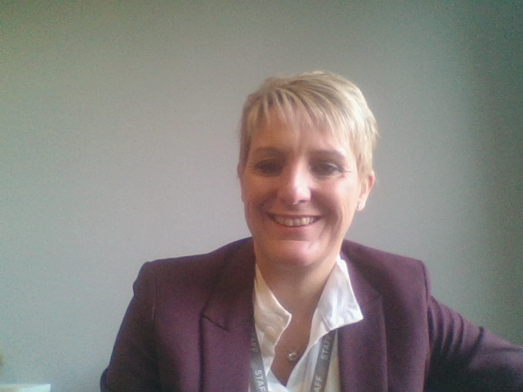
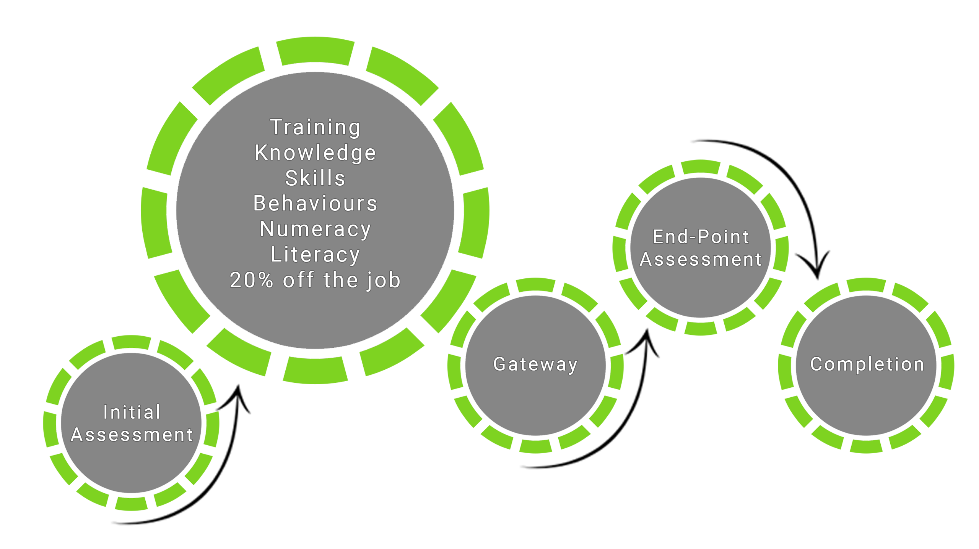

Head of Apprenticeships – Josephine Brammer
Welcome to the start of your journey within
Apprenticeships.
Do you want a change of direction and give something back to your industry and the new generation of apprentices?
This is the perfect time to think about joining our Reaseheath Apprenticeship team.
Great new opportunities are on the horizon due to fantastic growth we are currently experiencing particularly in Construction and Engineering (AgEng and PLANT).
INDUSTRY FOCUSED, CAREER READY

Slide 3

Key attributes for working within Apprenticeships
I am looking for enthusiastic people that are passionate about coaching, mentoring and training people.
I need people on my team who can be flexible, great communicators (can be challenging conversations at times), patient, pro-active, organised, digital skills, excellent time management and strive for outstanding professional behaviours.
People who welcome the new world of digital technology to support in coaching and mentoring employers and apprentices to succeed within their apprenticeship.
Please review the ‘Life of a Skills Coach’ and ‘Apprenticeship Delivery Manager’ case studies for further information on what it is really like to be part of the Apprenticeship team at Reaseheath College and the opportunities that could be available to you.
INDUSTRY FOCUSED, CAREER READY
INDUSTRY FOCUSED, CAREER READY

Slide 4

Useful websites to research if your interested in Apprenticeships and becoming part of the Reaseheath Apprenticeship Family:
Click the following links below for more information:
Institute for Apprenticeships – Standards
Gov.UK Apprenticeship links
Reaseheath Apprenticeships
If you would just like a chat about any of the roles advertised for Apprenticeships please don’t hesitate to contact me via email to arrange a convenient time for a informal chat:
 jo.brammer@reaseheath.ac.uk
We look forward to hearing from you!
INDUSTRY FOCUSED, CAREER READY

